Slide 1
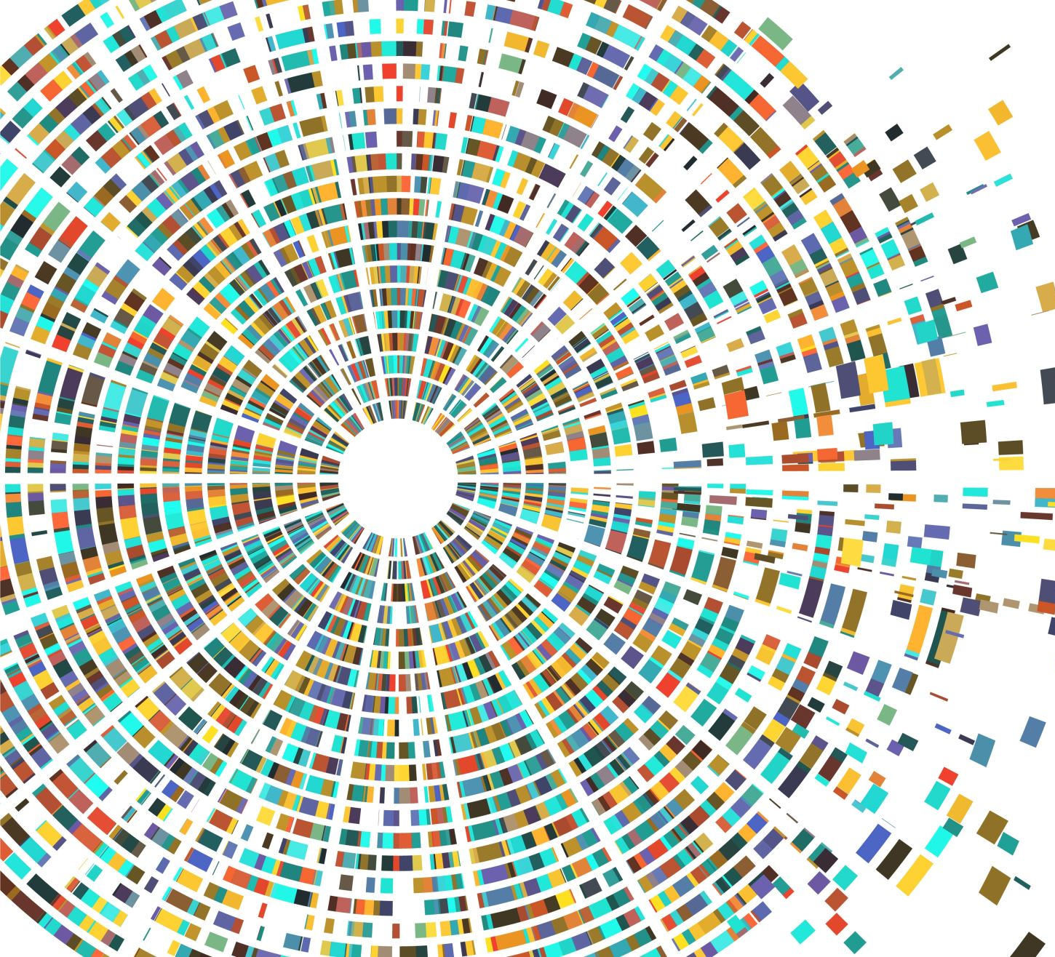

GANs and Computer Vision
COMS 6998
ADAEZE ADIGWE
IN WAI CHEONG

Slide 2
Recommended Slides Layout
1. Problem Motivation: 1-2 slides
2. Background work: 2 slides. Here you will mention all the papers you read and their main contribution.
3. Technical details and contribution of first paper: 2 slides
4. Technical details and contribution of second paper: 2 slides
5. Technical details and contribution of third paper: 2 slides
6. Technical details and contribution of fourth paper: 2 slides
7. Observation and Insights: 1-2 slide
8. Conclusion: 1 slide

Slide 3
Rubric
Number of papers covered (3)
Relevance of papers covered to the talk (3)
Novelty of topic and content (3)
Seminar Structure and Flow (3)
Technical Depth in the Presentation (8)
Clarity of Presentation (3)
Performance in question/answer (5)
New Insights and observation (2)

Slide 4
Problem Motivation
What are GAN’s?
How can they be applied to problems in computer vision?
How do we evaluate the performance of a model in CV tasks?

Slide 5
Background Work
Paper 1: Generative Adversarial Networks
Paper 2: Image-to-Image Translation with Conditional Adversarial Networks
Paper 3: InfoGAN: Interpretable Representation Learning by Information Maximizing GAN (Disentangled Representations)
Paper 4: Unsupervised Representation Learning with Deep Convolutional Generative Adversarial Networks

Slide 6
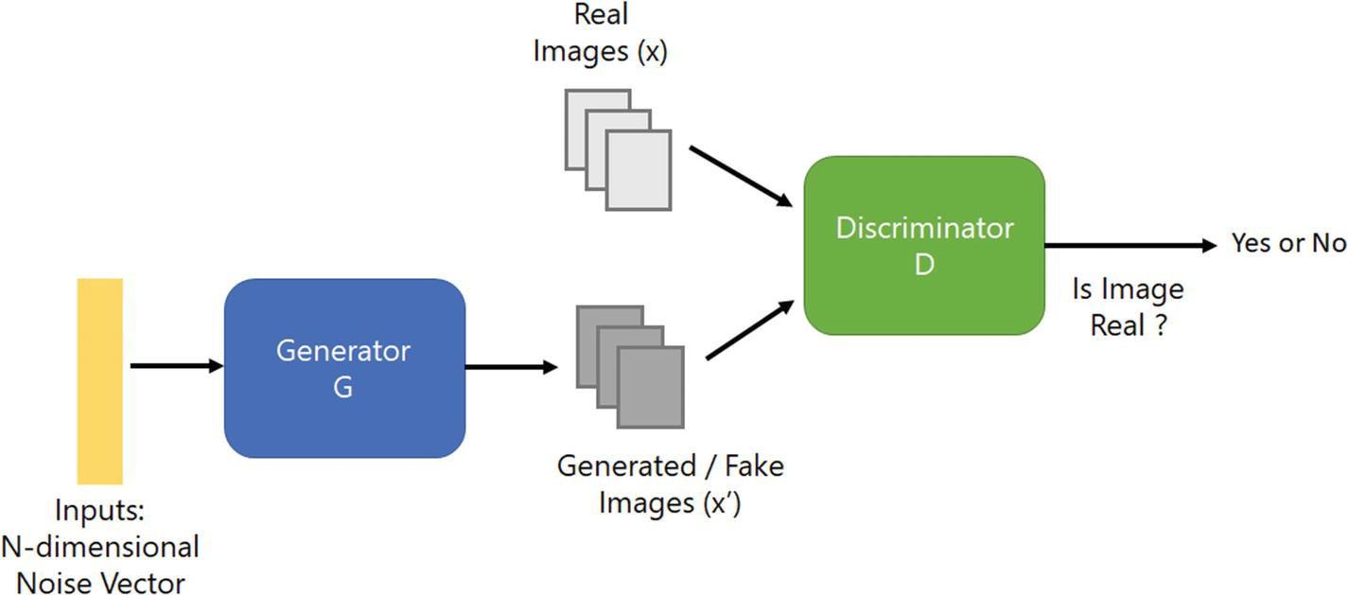
1st Paper:
(Generative Adversarial Networks)
GAN’s involve a generative model G and a discriminative model D

Slide 7
Mathematical Formulation (Paper 1]
V(G,D) is a value function, noise variables p(z)
Simultaneous training of G and D
The equation may not provide sufficient gradient for G to learn well

Slide 8
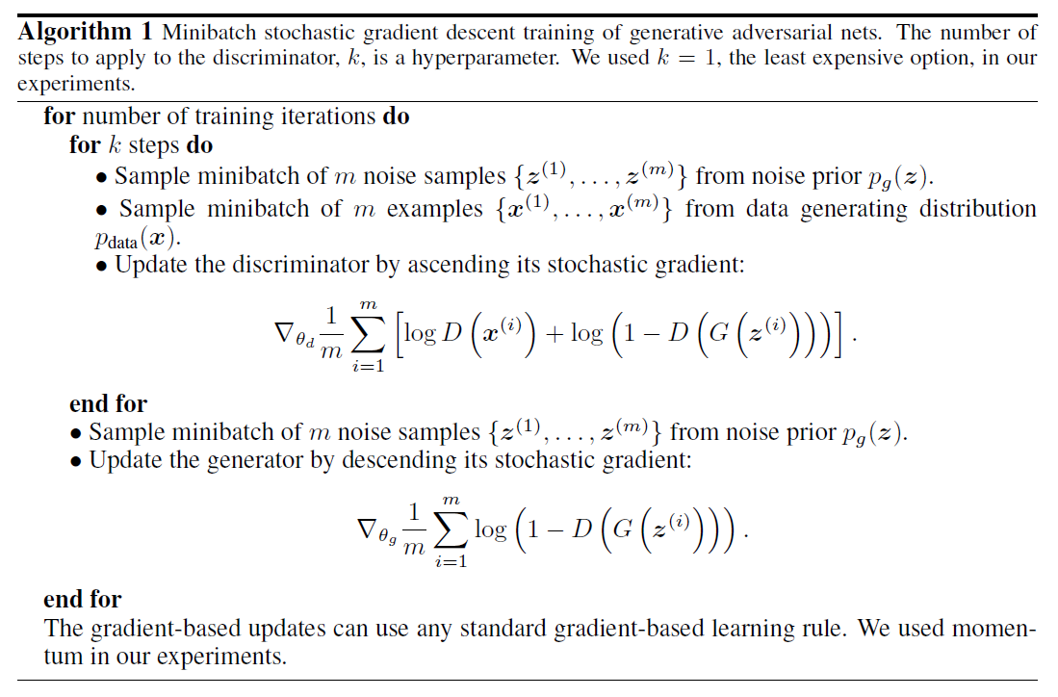

Slide 9
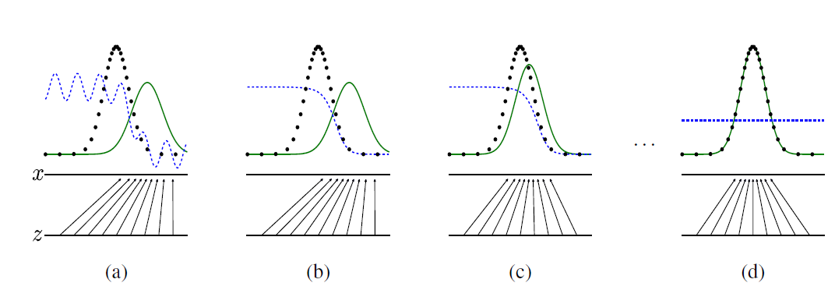
Algorithm

Slide 10
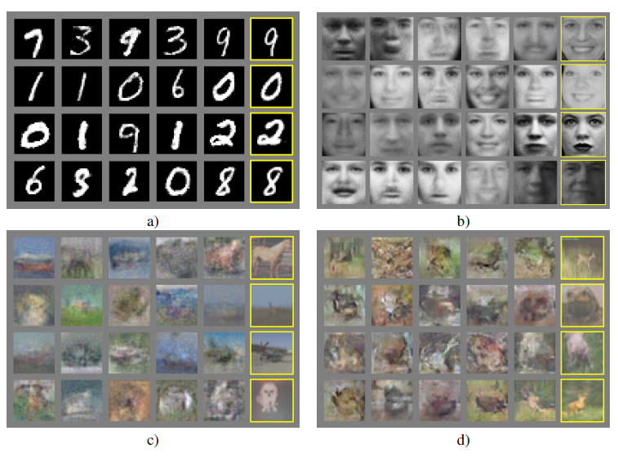

Slide 11
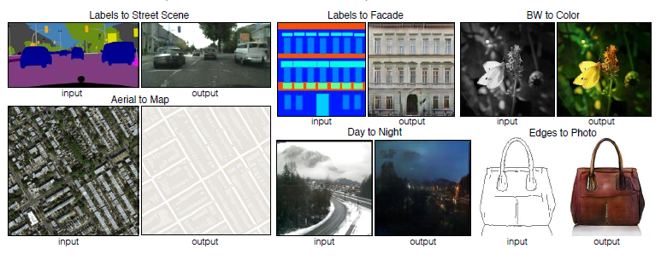
Paper 2
Image-to-Image Translation with Conditional Adversarial Networks

Slide 12
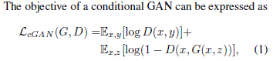
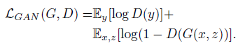
Objective
Unconditional Variant

Slide 13
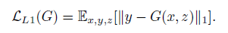
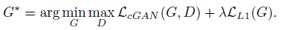
Objective(cont.)
L1 encourages less blurring
Final objective:

Slide 14
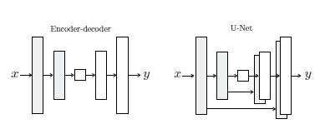
Generator with Skips
Encoder-decoder network (bottleneck layer)
We would like low-level information to go directly across the net
Skip connections
Both G and D use modules of the form Conv-BN-ReLu

Slide 15
PatchGAN
L1 and L2 loss produces blurry images on image generation problems
Captures low frequencies
PatchGAN - only penalizes structure at the scale of the patches
Run discriminator convolutionally across the image, averaging all responses to provide the output of D

Slide 16
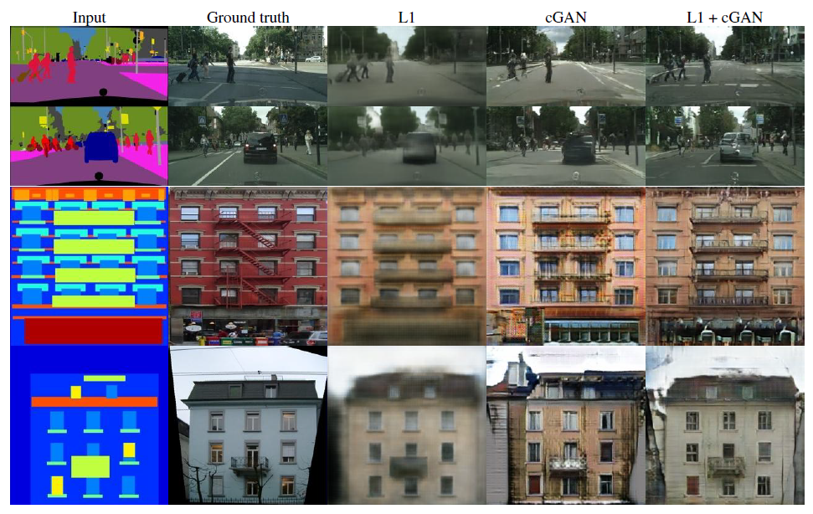

Slide 17
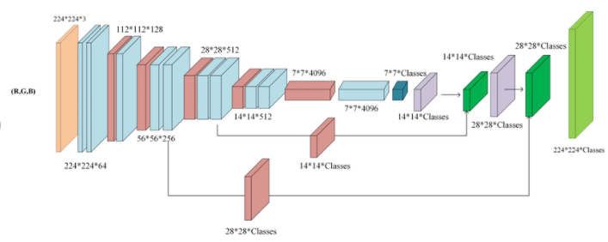
Evaluation Metrics
Problem with per pixel MSE
Amazon Mechanical Turk testing
Testing with off the shelf recognition systems

Slide 18
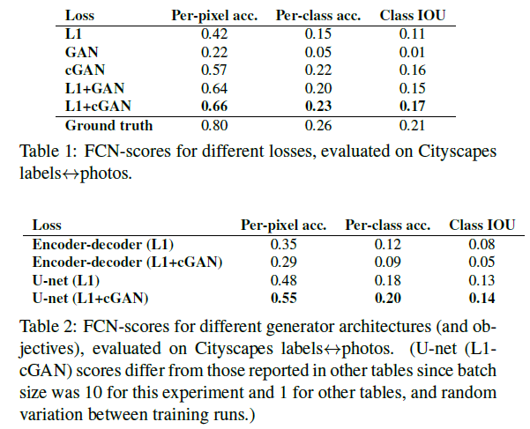
Comparisons

Slide 19
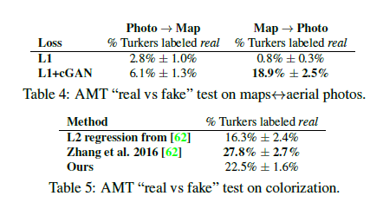
AMT Results

Slide 20
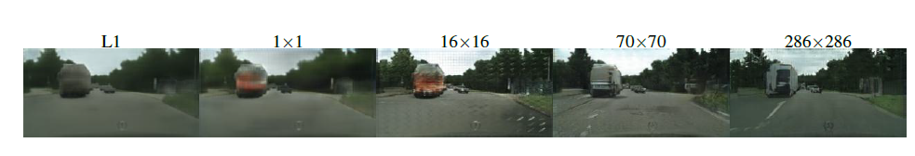
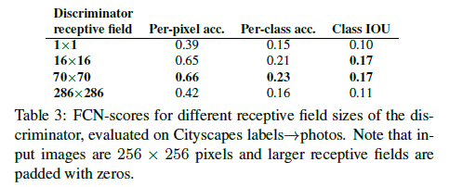
PatchGAN

Slide 21
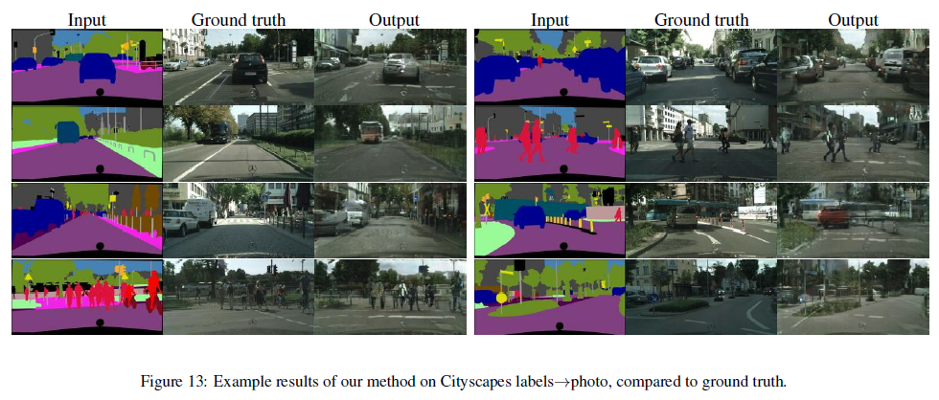
Experimental Results

Slide 22
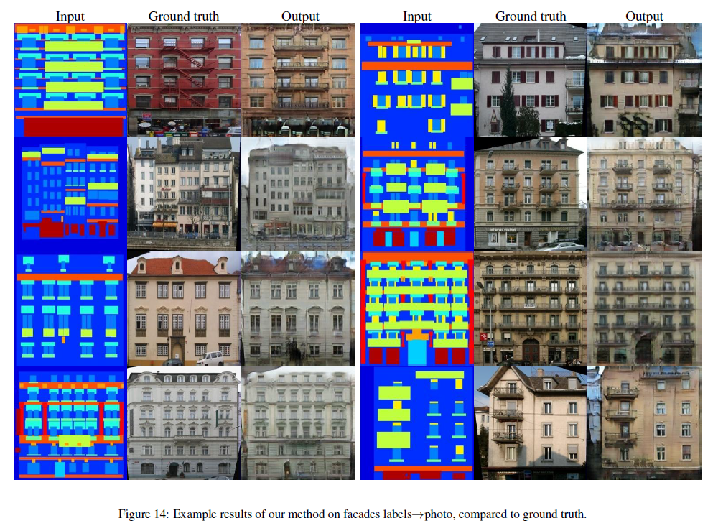

Slide 23
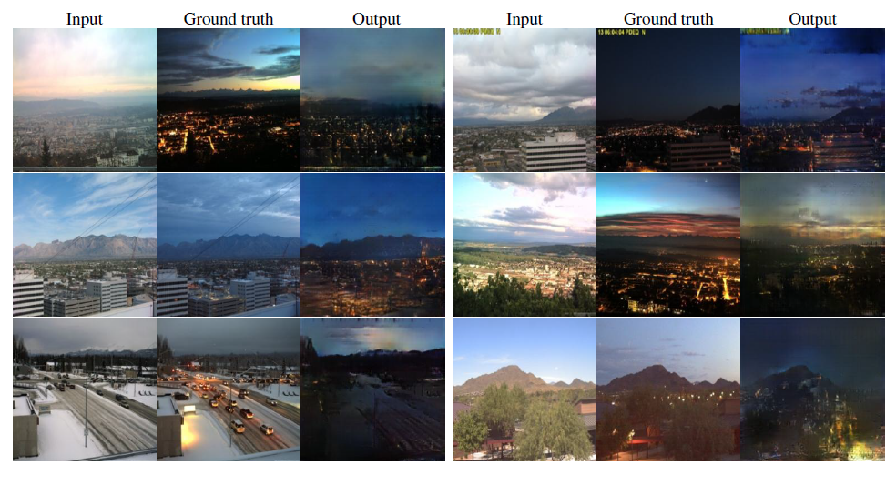

Slide 24
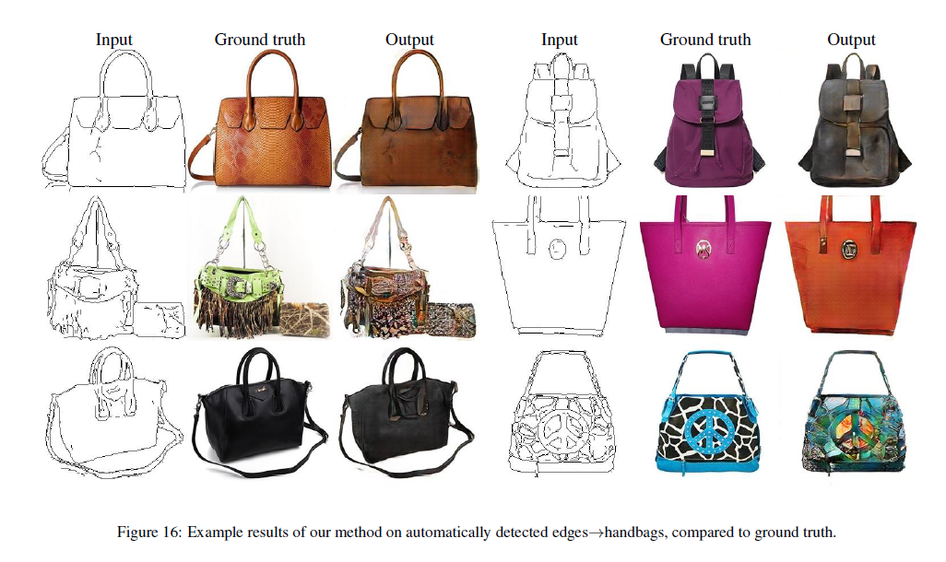

Slide 25
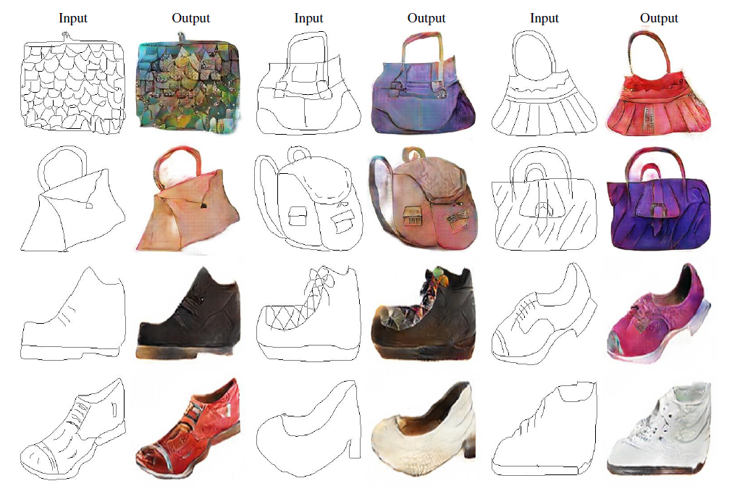

Slide 26
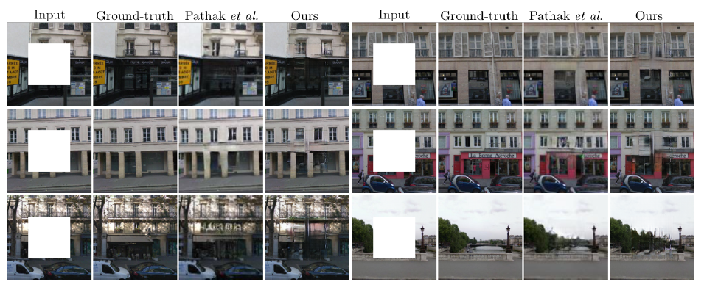

Slide 27
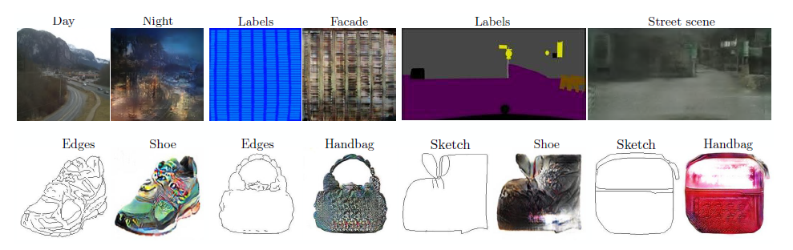
Failed Examples

Slide 28
Paper 3:
InfoGAN:
Interpretable Representation Learning by
Information Maximizing Generative Adversarial Nets
Chen, Duan, Houthooft, et. Al.

Slide 29
InfoGAN
Representation Learning is important for Unsupervised Learning
Modify GAN network objective to learn Interpretable and meaningful disentangled representation
GAN Noise Subset + Observations
Mutual Information for Latent Codes
Decompose the input noise vector
z - source of incompressible noise
c - latent code
Notes:
During Unsupervised learning, with the absence of labels, having a way to develop a representation of the data helps us to extract features that are useful for subsequent tasks.

Slide 30
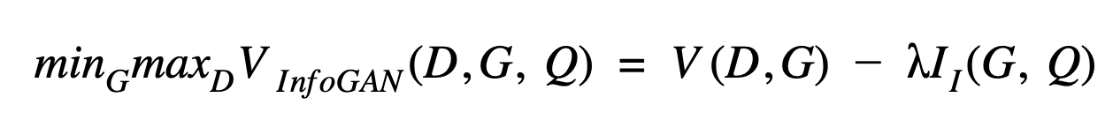
Training
Mutual Information
I(X; Y ) = H(X) − H(X|Y ) = H(Y ) − H(Y |X)
Objective Function

Slide 31
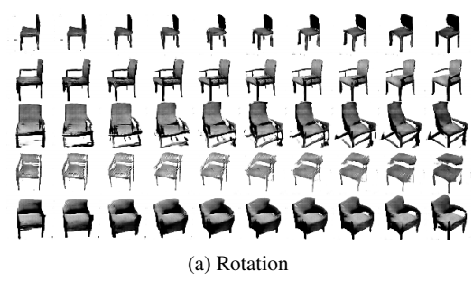
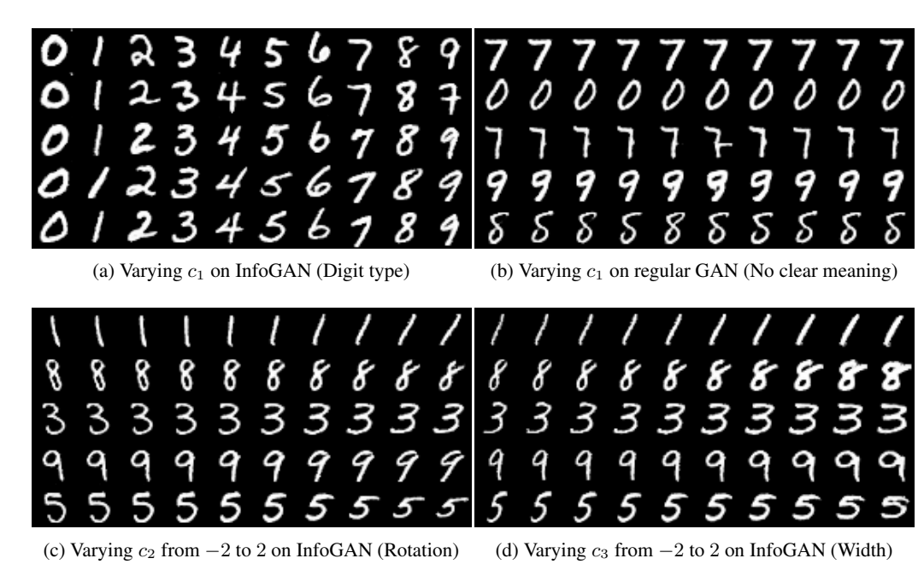
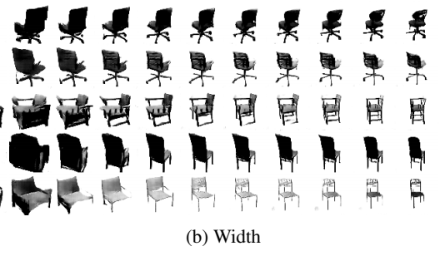
Results

Slide 32
Paper 4:
UNSUPERVISED REPRESENTATION LEARNING WITH DEEP CONVOLUTIONAL GENERATIVE ADVERSARIAL NETWORKS
(DCGANs)
Radford A, Metz L, Chintala S
ICLR 2016

Slide 33
Contributions
Image Representation for unsupervised learning

Slide 34
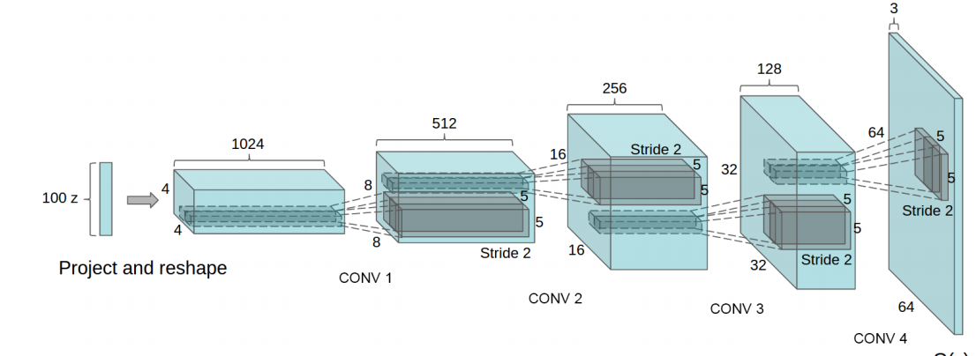
Model
Architecture
Strided Convolution
BatchNorm
Remove fully connected hidden layers
Relu in hidden layers
TanH for output

Slide 35
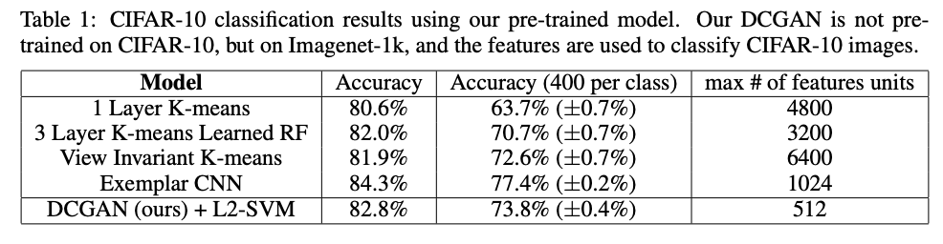
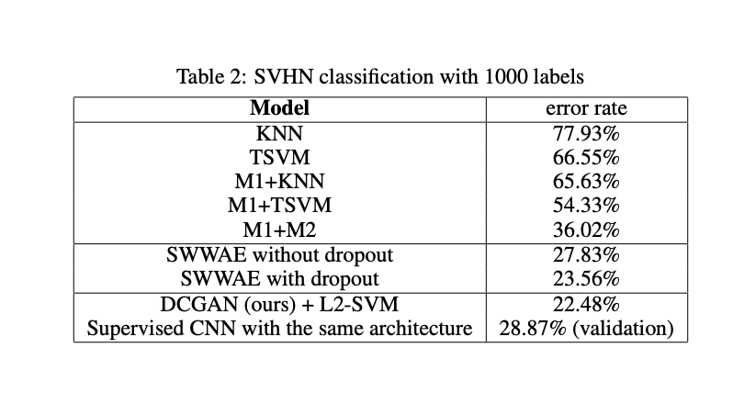
Empirical Validation
Street View House Numbers dataset
CIFAR 10 CLASSIFICATION
Evaluate the quality of unsupervised representation learning algorithms by applying them as a feature extractor on supervised datasets and evaluate the performance of linear models fitted on top of these features.

Slide 36
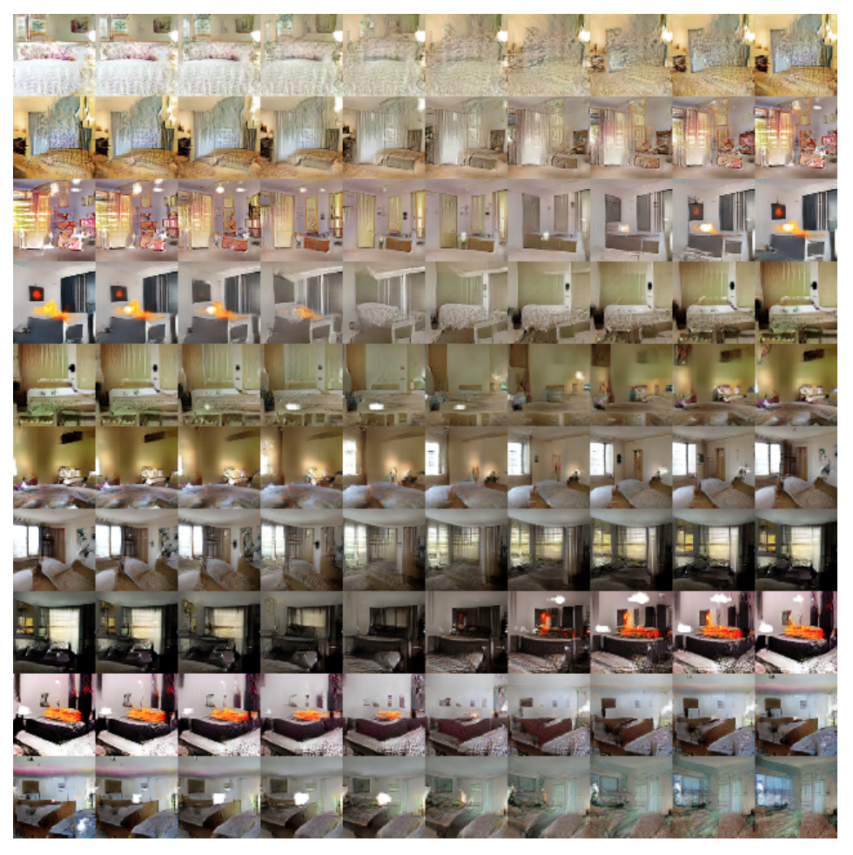
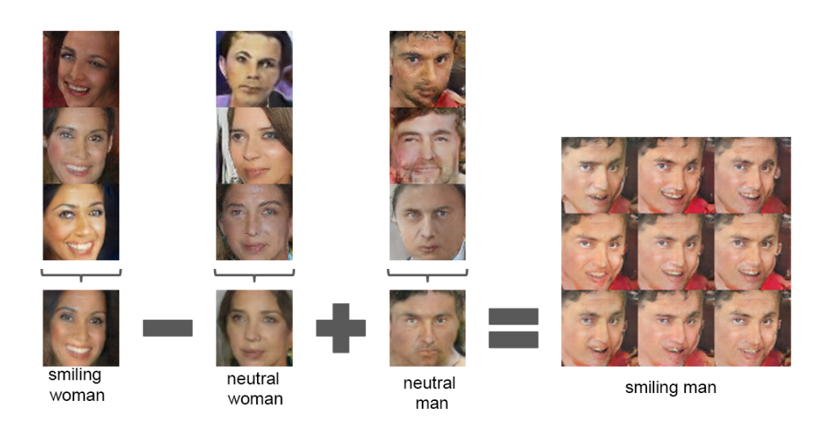
Results

Slide 37
References
https://medium.com/visionwizard/boolgan-dcgan-for-car-image-generation-a6bb4c1387ed

